Slide 1
Chapter Eleven
Voice and Data Delivery Networks
Data Communications and Computer Networks: A Business User’s Approach
Eighth Edition

Slide 2
After reading this chapter, you should be able to:
Identify the basic elements of a telephone system and discuss the limitations of telephone signals
Describe the composition of the telephone industry before and after the 1984 Modified Final Judgment and explain the differences
Describe the difference between a local exchange carrier and an interexchange carrier and list the services each offers
Differentiate between the roles of the local telephone company before and after the Telecommunications Act of 1996
Data Communications and Computer Networks: A Business User's Approach, Eighth Edition
© 2016. Cengage Learning. All Rights Reserved.

Slide 3
After reading this chapter, you should be able to (continued):
Identify the main characteristics of digital subscriber line, and recognize the difference between a symmetric system and an asymmetric system
Identify the main characteristics of a cable modem
List the basic characteristics of frame relay, such as permanent virtual circuits, committed information rate, and switched virtual circuits
Data Communications and Computer Networks: A Business User's Approach, Eighth Edition
© 2016. Cengage Learning. All Rights Reserved.

Slide 4
After reading this chapter, you should be able to (continued):
Identify the main characteristics of Asynchronous Transfer Mode, including the roles of the virtual path connection and the virtual channel connection, the importance of the classes of service available, and ATM’s advantages and disadvantages
Describe the concept of convergence, and identify several examples of it in the networking industry
Data Communications and Computer Networks: A Business User's Approach, Eighth Edition
© 2016. Cengage Learning. All Rights Reserved.

Slide 5
Introduction
Students used to go into either data communications or voice communications
Today, the two fields have merged
Or should we say that voice networks have given way to data networks and now data networks support both data and voice
Anyone studying the field of data communications and networks must learn some basic telecommunications too
Data Communications and Computer Networks: A Business User's Approach, Eighth Edition
© 2016. Cengage Learning. All Rights Reserved.

Slide 6
Telephone Lines, Trunks, and Numbers
The local loop is the telephone line that runs from the telephone company’s central office to your home or business
  Central office – building that houses the telephone company’s switching equipment and provides a local dial tone on your telephone
If you place a long-distance call, the central office passes your telephone call off to a long-distance provider
Data Communications and Computer Networks: A Business User's Approach, Eighth Edition
© 2016. Cengage Learning. All Rights Reserved.

Slide 7
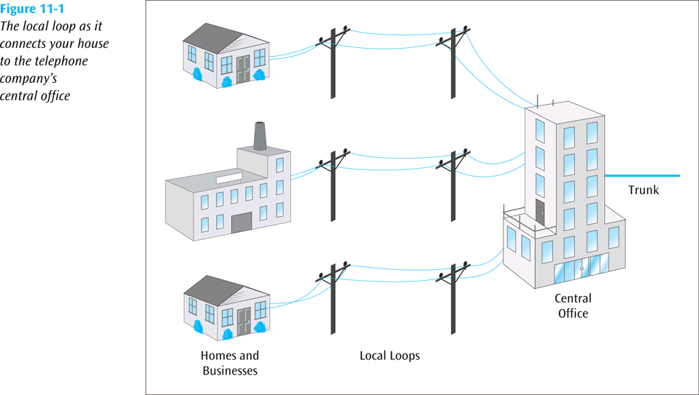
Telephone Lines, Trunks, and Numbers (continued)
Data Communications and Computer Networks: A Business User's Approach, Eighth Edition
© 2016. Cengage Learning. All Rights Reserved.

Slide 8
Telephone Lines, Trunks, and Numbers (continued)
The country is divided into a few hundred local access transport areas (LATAs)
  If your call goes from one LATA to another, it is a long-distance call and is handled by a long-distance telephone company
  If your call stays within a LATA, it is a local call and is handled by a local telephone company
Data Communications and Computer Networks: A Business User's Approach, Eighth Edition
© 2016. Cengage Learning. All Rights Reserved.

Slide 9
Telephone Lines, Trunks, and Numbers (continued)
Trunk – special telephone line that runs between central offices and other telephone switching centers
  Usually digital, high-speed, and carries multiple telephone circuits
  Typically a 4-wire circuit, while a telephone line is a 2-wire circuit
Data Communications and Computer Networks: A Business User's Approach, Eighth Edition
© 2016. Cengage Learning. All Rights Reserved.

Slide 10
Telephone Lines, Trunks, and Numbers (continued)
A trunk is not associated with a single telephone number like a line is
A telephone number consists of an area code, an exchange, and a subscriber extension
  The area code and exchange must start with the digits 2-9 to separate them from long distance and operator services
  How long until we have to make the telephone number larger?
Data Communications and Computer Networks: A Business User's Approach, Eighth Edition
© 2016. Cengage Learning. All Rights Reserved.
Notes:
Author has added additional slides on phone systems

Slide 11
Telephone Lines, Trunks, and Numbers (continued)
When telephone company installs a line, it must not proceed any further than 12 inches into the building
  This point is the demarcation point, or demarc
Modular connectors, such as the RJ-11, are commonly used to interconnect telephone lines and the telephone handset to the base
When handset is lifted off base (off-hook), an off-hook signal is sent to the central office
Data Communications and Computer Networks: A Business User's Approach, Eighth Edition
© 2016. Cengage Learning. All Rights Reserved.

Slide 12
Telephone Lines, Trunks, and Numbers (continued)
When off-hook signal arrives at central office, a dial tone is generated and returned to telephone
When user hears the dial tone, they dial (or press) number
The central office equipment collects dialed digits, and proceeds to place appropriate call
Data Communications and Computer Networks: A Business User's Approach, Eighth Edition
© 2016. Cengage Learning. All Rights Reserved.

Slide 13
Telephone Lines, Trunks, and Numbers (continued)
POTS – plain old telephone service – the landline telephone system we know today
Private Branch Exchange (PBX) – common internal phone switching system for medium- to large-sized businesses
Centrex (central office exchange service) is like having a PBX but the PBX resides at the local telephone company
Private lines are leased, permanent telephone circuits; opposite of dial-up lines
Data Communications and Computer Networks: A Business User's Approach, Eighth Edition
© 2016. Cengage Learning. All Rights Reserved.

Slide 14
The Telephone Network
Before and After 1984
In 1984, U.S. government broke up AT&T
Before then, AT&T owned large majority of all local telephone circuits and all the long-distance service
With Modified Final Judgment (MFJ) of 1984, AT&T had to split off local telephone companies from long-distance company
  The local telephone companies formed seven Regional Bell Operating Companies
    Today, there are only 3 left: AT&T (Southwestern Bell, Bell South, Ameritech, Pacific Telesis), CenturyLink (US West), and Verizon (Bell Atlantic, NYNEX)
Data Communications and Computer Networks: A Business User's Approach, Eighth Edition
© 2016. Cengage Learning. All Rights Reserved.

Slide 15
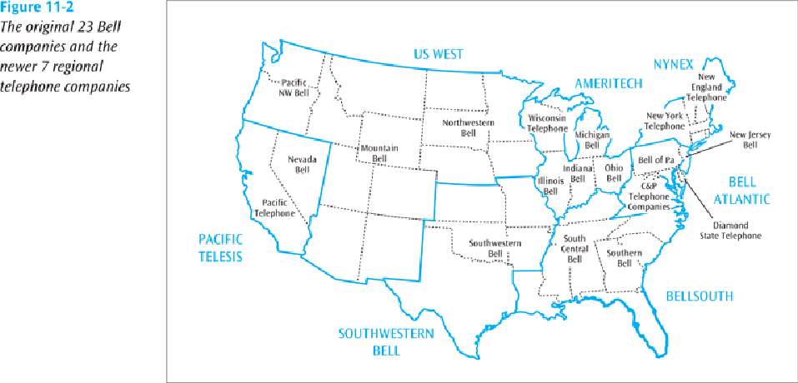
The Telephone Network
Before and After 1984 (continued)
Data Communications and Computer Networks: A Business User's Approach, Eighth Edition
© 2016. Cengage Learning. All Rights Reserved.

Slide 16
The Telephone Network
Before and After 1984 (continued)
Another result of the Modified Judgment was creation of LATA (local access and transport area)
Local telephone companies became known as local exchange carriers (LECs), and long distance telephone companies became known as interexchange carriers (IEC, or IXC)
Calls that remain within LATA are intra-LATA, or local calls
Calls that pass from one LATA to another are inter-LATA, or long distance
Data Communications and Computer Networks: A Business User's Approach, Eighth Edition
© 2016. Cengage Learning. All Rights Reserved.

Slide 17
The Telephone Network
Before and After 1984 (continued)
Before 1984, telephone networks in the U.S. resembled a large hierarchical tree, with Class 5 offices at the bottom and Class 1 offices at the top
  Users were connected to Class 5 offices
  The longer the distance of a telephone call, the further up the tree the call progressed
Today’s telephone structure is a collection of LECs, POPs, and IECs
Data Communications and Computer Networks: A Business User's Approach, Eighth Edition
© 2016. Cengage Learning. All Rights Reserved.

Slide 18
Summary – Results of MFJ
AT&T could not control everything
Difference between local distance and long distance clearly defined
Users could select their own long distance carrier
AT&T had to allow other long distance phone companies access to their switching centers
Data Communications and Computer Networks: A Business User's Approach, Eighth Edition
© 2016. Cengage Learning. All Rights Reserved.

Slide 19
Telecomm Act of 1996
Another landmark ruling affecting the telephone industry was the Telecommunications Act of 1996
  Opened up local telephone market to competitors
Now cable TV companies (cable telephony), long-distance telephone companies, or anyone that wants to start a local telephone company can offer local telephone service
Local phone companies that existed before the Act are known as incumbent local exchange carriers (ILEC) while the new companies are competitive local exchange carriers (CLEC)
Data Communications and Computer Networks: A Business User's Approach, Eighth Edition
© 2016. Cengage Learning. All Rights Reserved.

Slide 20
Telecomm Act of 1996 (continued)
LECs are supposed to allow CLECs access to all local loops and switching centers / central offices
If a local loop is damaged, the LEC is responsible for repair
The LEC is also supposed to provide the CLEC with a discount to the dial tone (17-20%)
LECs can also provide long-distance service if they can show there is sufficient competition at the local service level
Data Communications and Computer Networks: A Business User's Approach, Eighth Edition
© 2016. Cengage Learning. All Rights Reserved.

Slide 21
Results of Telecomm Act of 1996
Users now have a “choice” of local telephone providers, but this didn’t work as well as MFJ
Choices include original provider (like AT&T), cable television company, VoIP over Internet, or none at all (many drop land line in favor of cellular service only)
Mega-phone companies (like AT&T) are coming back
Data Communications and Computer Networks: A Business User's Approach, Eighth Edition
© 2016. Cengage Learning. All Rights Reserved.

Slide 22
Limitations of Telephone Signals
POTS lines were designed to transmit the human voice, which has a bandwidth less than 4000 Hz
A telephone conversation requires two channels, each occupying 4000 Hz
Data Communications and Computer Networks: A Business User's Approach, Eighth Edition
© 2016. Cengage Learning. All Rights Reserved.

Slide 23
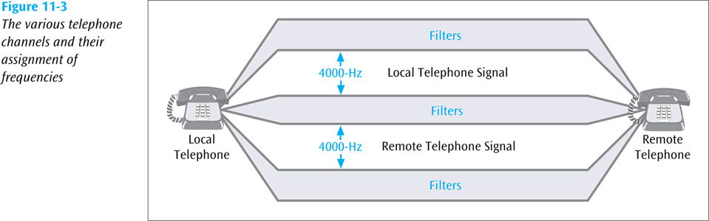
Limitations of Telephone Signals (continued)
Data Communications and Computer Networks: A Business User's Approach, Eighth Edition
© 2016. Cengage Learning. All Rights Reserved.

Slide 24
Limitations of Telephone Signals (continued)
A 4000 Hz analog signal can only carry about 33,600 bits per second of information while a 4000 Hz digital signal can carry about 56,000 bits per second
If you want to send information faster, you need a signal with a higher frequency or you need to incorporate more advanced modulation techniques
Data Communications and Computer Networks: A Business User's Approach, Eighth Edition
© 2016. Cengage Learning. All Rights Reserved.

Slide 25
Dial-Up Internet Service
Once upon a time most Internet users used a dial-up service, such as a 56k modem
A 56k modem (56,000 bps) achieves this speed by combining digital signaling with analog signaling
Data Communications and Computer Networks: A Business User's Approach, Eighth Edition
© 2016. Cengage Learning. All Rights Reserved.

Slide 26
Dial-Up Internet Service (continued)
Would actually achieve 64k except:
  Local loop is still analog, thus analog signaling
  Analog to digital conversion at the local modem introduces noise/error
  Combined, these shortcomings drop the speed to at best 56k
Doesn’t even reach 56k due to line noise and other factors
Data Communications and Computer Networks: A Business User's Approach, Eighth Edition
© 2016. Cengage Learning. All Rights Reserved.

Slide 27
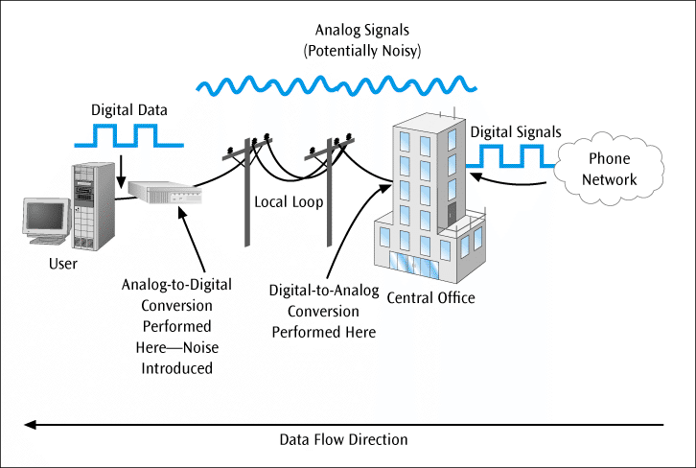
Dial-Up Internet Service (continued)
Figure 11-4
The analog and digital forms of a telephone connection between a home and the central office
Data Communications and Computer Networks: A Business User's Approach, Eighth Edition
© 2016. Cengage Learning. All Rights Reserved.

Slide 28
Dial-Up Internet Service (continued)
Based upon one of two standards:
  V.90
    Upstream speed is maximum 33,600 bps
  V.92
    Newer standard
    Allows maximum upstream speed of 48 kbps (under ideal conditions)
    Can place a data connection on hold if the telephone service accepts call waiting and a voice telephone call arrives
Data Communications and Computer Networks: A Business User's Approach, Eighth Edition
© 2016. Cengage Learning. All Rights Reserved.

Slide 29
Digital Subscriber Line
56k dial-up modems are disappearing (too slow!)
What is replacing 56k for in home Internet access?
  DSL can provide very high data transfer rates over standard telephone lines
  Cable modems (but let’s look at DSL first)
Data Communications and Computer Networks: A Business User's Approach, Eighth Edition
© 2016. Cengage Learning. All Rights Reserved.

Slide 30
DSL Basics
DSL, depending on the type of service, is capable of transmission speeds from 100s of kilobits into single-digit megabits
Because DSL is highly dependent upon noise levels, a subscriber cannot be any more than 5.5 kilometers (2-3 miles) from the DSL central office
DSL service can be:
  Symmetric – downstream and upstream speeds are identical
  Asymmetric – downstream speed is faster than the upstream speed
Data Communications and Computer Networks: A Business User's Approach, Eighth Edition
© 2016. Cengage Learning. All Rights Reserved.

Slide 31
DSL Basics (continued)
DSL service
  Often connects a user to the Internet
  Can also provide a regular telephone service (POTS)
The DSL provider uses a DSL access multiplexer (DSLAM) to split off the individual DSL lines into homes and businesses
  A user then needs a splitter to separate the POTS line from the DSL line, and then a DSL modem to convert the DSL signals into a form recognized by the computer
Data Communications and Computer Networks: A Business User's Approach, Eighth Edition
© 2016. Cengage Learning. All Rights Reserved.

Slide 32
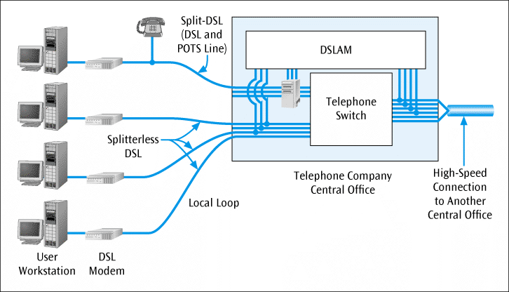
DSL Basics (continued)
Figure 11-5
The four necessary components of a DSL connection
Data Communications and Computer Networks: A Business User's Approach, Eighth Edition
© 2016. Cengage Learning. All Rights Reserved.

Slide 33
DSL Formats
A DSL service comes in many different forms:
  ADSL (Asymmetric DSL)
  DSL Lite
    Slower form than ADSL
  VDSL2 (Very high data rate DSL2)
  RADSL (Rate-adaptive DSL)
    Speed varies depending on noise level
Data Communications and Computer Networks: A Business User's Approach, Eighth Edition
© 2016. Cengage Learning. All Rights Reserved.

Slide 34
Cable Modems
Allow high-speed access to wide area networks such as the Internet
Most are external devices that connect to the personal computer through a common Ethernet card
Can provide data transfer speeds between 500 kbps and 25 Mbps
Data Communications and Computer Networks: A Business User's Approach, Eighth Edition
© 2016. Cengage Learning. All Rights Reserved.

Slide 35
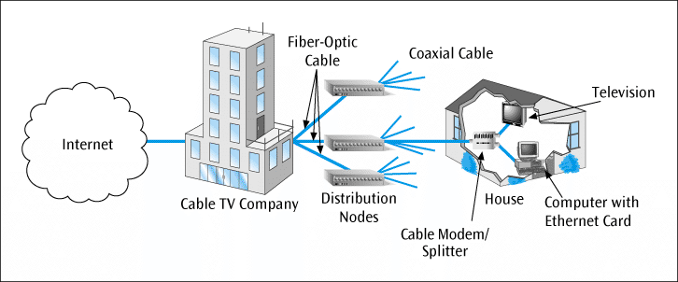
Cable Modems (continued)
Figure 11-6
Cable modem connecting a personal computer to the Internet via a cable television connection
Data Communications and Computer Networks: A Business User's Approach, Eighth Edition
© 2016. Cengage Learning. All Rights Reserved.

Slide 36
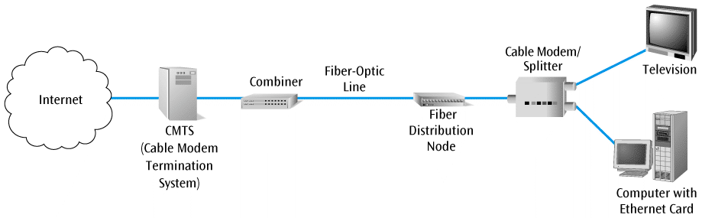
Cable Modems (continued)
Figure 11-7
Basic architecture and components of a cable modem system
Data Communications and Computer Networks: A Business User's Approach, Eighth Edition
© 2016. Cengage Learning. All Rights Reserved.

Slide 37
T-1 Leased Line Service
DSL and cable modems are great for home users and small commercial users. But what else is there for commercial users?
T-1 – digital service offered by the telephone companies that can transfer data as fast as 1.544 Mbps (both voice and computer data)
To support a T-1 service, a channel service unit / data service unit (CSU/DSU) is required at the end of the connection
Data Communications and Computer Networks: A Business User's Approach, Eighth Edition
© 2016. Cengage Learning. All Rights Reserved.

Slide 38
T-1 Leased Line Service (continued)
A T-1 service
  Is a digital, synchronous TDM stream used by businesses and telephone companies
  Is always on and always transmitting
  Can support up to 24 simultaneous channels
    These channels can be either voice or data (PBX support)
  Can also be provisioned as a single channel delivering 1.544 Mbps of data (LAN to ISP connection)
Data Communications and Computer Networks: A Business User's Approach, Eighth Edition
© 2016. Cengage Learning. All Rights Reserved.

Slide 39
T-1 Leased Line Service (continued)
A T-1 service (continued)
  Requires 4 wires, as opposed to a 2-wire telephone line
  Can be either intra-LATA (local) which costs roughly $350-$400 per month, or inter-LATA (long distance) which can cost thousands of dollars per month (usually based on distance)
    A customer may also be able to order a 1/4 T-1 or a 1/2 T-1 (fractional T-1)
Data Communications and Computer Networks: A Business User's Approach, Eighth Edition
© 2016. Cengage Learning. All Rights Reserved.

Slide 40
T-1 Leased Line Service (continued)
Constantly transmits frames (8000 frames per second)
  Each frame consists of one byte from each of the 24 channels, plus 1 sync bit (8 * 24 + 1 = 193 bits)
    8000 frames per second * 193 bits per frame = 1.544 Mbps
  If a channel is used for voice, each byte is one byte of PCM-encoded voice
  If a channel is used for data, each byte contains 7 bits of data and 1 bit of control information (7 * 8000 = 56 kbps)
Data Communications and Computer Networks: A Business User's Approach, Eighth Edition
© 2016. Cengage Learning. All Rights Reserved.

Slide 41
T-1 Alternatives
There are a number of alternatives to using the often costly T-1 lines, especially for long distances
Let’s take a look at frame relay, asynchronous transfer mode, and MPLS/VPN
Data Communications and Computer Networks: A Business User's Approach, Eighth Edition
© 2016. Cengage Learning. All Rights Reserved.

Slide 42
Frame Relay
Leased service that can provide a high-speed connection for data transfer between two points either locally or over long distances
A business only has to connect itself to local frame relay port
  Hopefully this connection is a local telephone call
  Once data reaches local frame relay port, the frame relay network, or cloud, transmits the data to the other side
Data Communications and Computer Networks: A Business User's Approach, Eighth Edition
© 2016. Cengage Learning. All Rights Reserved.

Slide 43
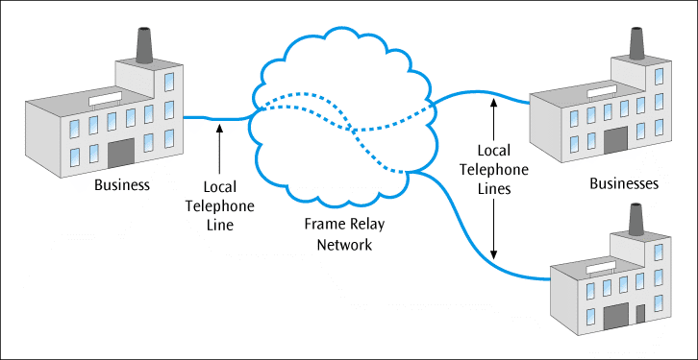
Frame Relay (continued)
Figure 11-8
Three businesses connected to the frame relay cloud via local connections
Data Communications and Computer Networks: A Business User's Approach, Eighth Edition
© 2016. Cengage Learning. All Rights Reserved.

Slide 44
Frame Relay (continued)
Permanent virtual circuit (PVC) – connection between two endpoints
  Created by the provider of the frame relay service
The user uses a high-speed telephone line to connect its company to a port, which is the entryway to the frame relay network
The high-speed line, the port, and the PVC should all be chosen to support a desired transmission speed
Data Communications and Computer Networks: A Business User's Approach, Eighth Edition
© 2016. Cengage Learning. All Rights Reserved.

Slide 45
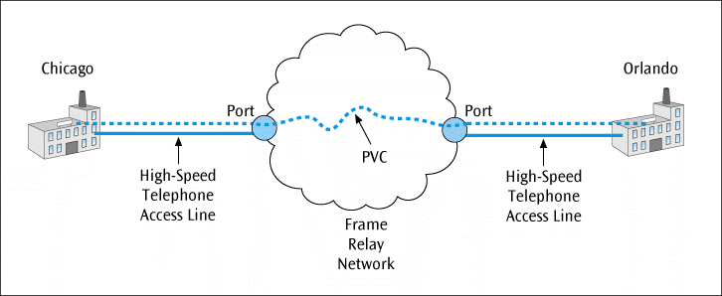
Frame Relay (continued)
Figure 11-9
A frame relay connection between Chicago and Orlando, showing access lines, ports, and PVC
Data Communications and Computer Networks: A Business User's Approach, Eighth Edition
© 2016. Cengage Learning. All Rights Reserved.

Slide 46
Committed Information Rate (CIR)
The user and frame relay service would agree upon a committed information rate (CIR)
The CIR states that if the customer stays within a specified data rate (standard rate plus a burst rate) the frame relay provider will guarantee delivery of 99.99% of the frames
The burst rate cannot be exceeded for longer than 2 seconds
Data Communications and Computer Networks: A Business User's Approach, Eighth Edition
© 2016. Cengage Learning. All Rights Reserved.

Slide 47
Committed Information Rate (CIR) (continued)
Example – if a company agrees to a CIR of 512 kbps with a burst rate of 256 kbps, the company must stay at or below 512 kbps, with an occasional burst up to 768 kbps, as long as the burst does not last longer than 2 seconds
  If the company maintains their end of the agreement, the carrier will provide something like 99.99% throughput and a network delay of no longer than 20 ms
  If the customer exceeds its CIR, and the network becomes congested, the customer’s frames may be discarded
Data Communications and Computer Networks: A Business User's Approach, Eighth Edition
© 2016. Cengage Learning. All Rights Reserved.

Slide 48
Asynchronous Transfer Mode (ATM)
Asynchronous Transfer Mode (ATM) – very high-speed packet-switched service, similar in a number of ways to frame relay
Both send packets of data over high-speed lines
Both require a user to create a circuit with a provider
One noticeable difference between ATM and frame relay is speed
  ATM is capable of speeds up to 622 Mbps while frame relay’s maximum is typically 45 Mbps
Data Communications and Computer Networks: A Business User's Approach, Eighth Edition
© 2016. Cengage Learning. All Rights Reserved.

Slide 49
Asynchronous Transfer Mode (ATM) (continued)
Similar to frame relay, data travels over a connection called a virtual channel connection (VCC)
To better manage VCCs, a VCC must travel over a virtual path connection (VPC)
One of ATM’s strengths (besides its high speeds) is its ability to offer various classes of service
Data Communications and Computer Networks: A Business User's Approach, Eighth Edition
© 2016. Cengage Learning. All Rights Reserved.

Slide 50
ATM Classes of Service
If a company requires a high-speed, continuous connection, they might consider a constant bit rate service (CBR). CBR customers get first access to ATM “pipe”.
A less demanding service is variable bit rate (VBR). VBR customers are allowed on the ATM “pipe” right after CBR customers
  VBR can also support real-time applications (rt-VBR), as well as non-real-time applications (nrt-VBR), but do not demand a constant bit stream
Data Communications and Computer Networks: A Business User's Approach, Eighth Edition
© 2016. Cengage Learning. All Rights Reserved.

Slide 51
ATM Classes of Service (continued)
Available bit rate (ABR) is used for bursty traffic that does not need to be transmitted immediately
  ABR traffic may be held up until a transmission opening is available
Unspecified bit rate (UBR) is for lower rate traffic that may get held up, and may even be discarded part way through transmission if congestion occurs
Data Communications and Computer Networks: A Business User's Approach, Eighth Edition
© 2016. Cengage Learning. All Rights Reserved.

Slide 52
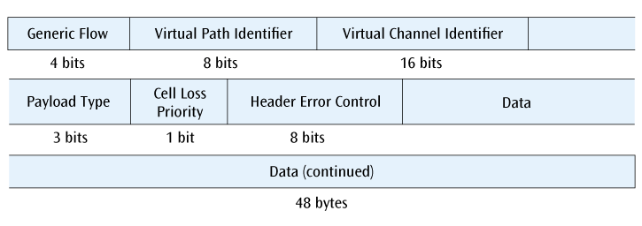
ATM Cell Composition
Figure 11-10
The 53-byte ATM cell with its individual fields
Data Communications and Computer Networks: A Business User's Approach, Eighth Edition
© 2016. Cengage Learning. All Rights Reserved.

Slide 53
Advantages and Disadvantages of ATM
Advantages of ATM include very high speeds and the different classes of service
Disadvantages include potentially higher costs (both equipment and support) and a higher level of complexity
Data Communications and Computer Networks: A Business User's Approach, Eighth Edition
© 2016. Cengage Learning. All Rights Reserved.

Slide 54
MPLS and VPNs
Frame relay and ATM are declining in popularity due to more people using the Internet
But you can’t just send potentially important data over the Internet without doing something first
One thing businesses are doing is applying MPLS labels to the IP packets
The use of MPLS routes data packets quickly through the Internet
And as we have also seen, VPNs (virtual private networks) create secure tunnels
Data Communications and Computer Networks: A Business User's Approach, Eighth Edition
© 2016. Cengage Learning. All Rights Reserved.

Slide 55
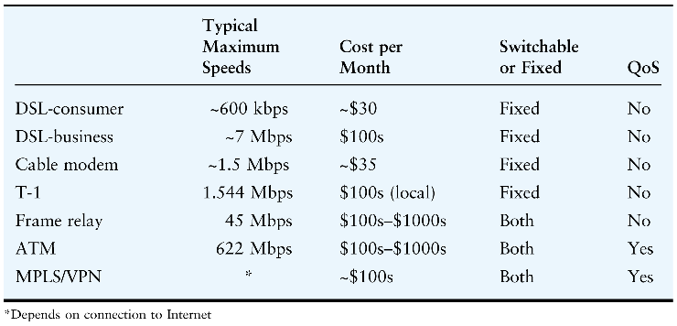
Comparison of DSL, Cable Modems, Frame Relay, and ATM
Data Communications and Computer Networks: A Business User's Approach, Eighth Edition
© 2016. Cengage Learning. All Rights Reserved.

Slide 56
Convergence
Big issue in the voice and data delivery industry
Phone companies are buying other phone companies
Older technologies are falling by the wayside as newer technologies take over a larger share of the market
Newer devices are incorporating multiple applications
Computer telephony integration is one large example of convergence
Data Communications and Computer Networks: A Business User's Approach, Eighth Edition
© 2016. Cengage Learning. All Rights Reserved.

Slide 57
Computer-Telephony Integration (CTI)
Field that combines more traditional voice networks with modern computer networks
Consider a system in which a customer calls a customer support number
  The customer’s telephone number appears on the customer support rep’s terminal and immediately pulls up the customer’s data
  The rep answers the phone by clicking on an icon on the screen and helps the customer
  The rep transfers the call by clicking on another icon on the computer screen
Data Communications and Computer Networks: A Business User's Approach, Eighth Edition
© 2016. Cengage Learning. All Rights Reserved.

Slide 58
Computer-Telephony Integration (CTI) (continued)
CTI can also integrate voice cabling with data cabling
The company PBX talks directly to the LAN server
  The PBX can direct the LAN server to provide a telephone operation to the user through the user’s computer
The telephones may still be connected to the PBX or they may be connected to the LAN via the LAN wiring
Data Communications and Computer Networks: A Business User's Approach, Eighth Edition
© 2016. Cengage Learning. All Rights Reserved.

Slide 59
Computer-Telephony Integration (CTI) (continued)
CTI applications could include the following:
  Unified messaging
  Interactive voice response
  Integrated voice recognition and response
  Fax processing and fax-back
  Text-to-speech and speech-to-text conversions
Data Communications and Computer Networks: A Business User's Approach, Eighth Edition
© 2016. Cengage Learning. All Rights Reserved.

Slide 60
Computer-Telephony Integration (CTI) (continued)
CTI applications could include the following: (continued)
  Third-party call control
  PBX graphic user interface
  Call filtering
  Customized menuing systems
Data Communications and Computer Networks: A Business User's Approach, Eighth Edition
© 2016. Cengage Learning. All Rights Reserved.

Slide 61
Unified Communications
Just as CTI is a convergence of multiple technologies and applications, unified communications is the convergence of real-time and non-real-time communications
For example, convergence of telephony, instant messaging, video conferencing, voice mail, e-mail, and presence information into one or more applications
Data Communications and Computer Networks: A Business User's Approach, Eighth Edition
© 2016. Cengage Learning. All Rights Reserved.

Slide 62
Telecommunication Systems In Action:
A Company Makes a Service Choice
Better Box Corporation has offices in Seattle, San Francisco, and Dallas, with headquarters in Chicago
Better Box wants to connect Chicago to each of the other three offices
Better Box needs to download 400k byte files in 20 seconds
  This requires a transmission speed of 160,000 bps
Data Communications and Computer Networks: A Business User's Approach, Eighth Edition
© 2016. Cengage Learning. All Rights Reserved.

Slide 63
Telecommunication Systems In Action:
A Company Makes a Service Choice (continued)
What could Better Box use for communications?
  56kbps dial-up?
  T-1?
  Frame relay?
  ATM?
  MPLS/VPN over the Internet?
Data Communications and Computer Networks: A Business User's Approach, Eighth Edition
© 2016. Cengage Learning. All Rights Reserved.

Slide 64
Telecommunication Systems In Action:
A Company Makes a Service Choice (continued)
56 kbps lines are too slow for our application
T-1s, frame relay, and ATM appear to be viable choices
We should be able to create a VPN using MPLS over the Internet
Data Communications and Computer Networks: A Business User's Approach, Eighth Edition
© 2016. Cengage Learning. All Rights Reserved.

Slide 65
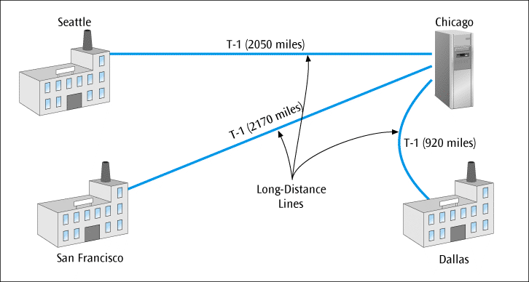
Telecommunication Systems In Action:
A Company Makes a Service Choice (continued)
Figure 11-11
Three T-1 lines connecting the three regional offices to Chicago
Data Communications and Computer Networks: A Business User's Approach, Eighth Edition
© 2016. Cengage Learning. All Rights Reserved.

Slide 66
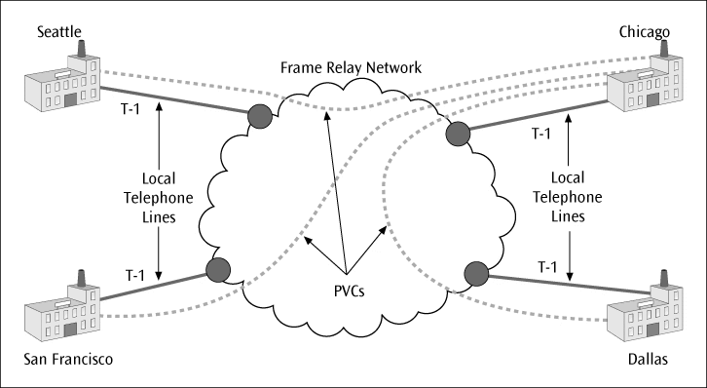
Telecommunication Systems In Action:
A Company Makes a Service Choice (continued)
Figure 11-12
Four cities connected to the frame relay cloud
Data Communications and Computer Networks: A Business User's Approach, Eighth Edition
© 2016. Cengage Learning. All Rights Reserved.

Slide 67
Telecommunication Systems In Action:
A Company Makes a Service Choice (continued)
Typical various prices for these services are shown on the next table
Data Communications and Computer Networks: A Business User's Approach, Eighth Edition
© 2016. Cengage Learning. All Rights Reserved.

Slide 68
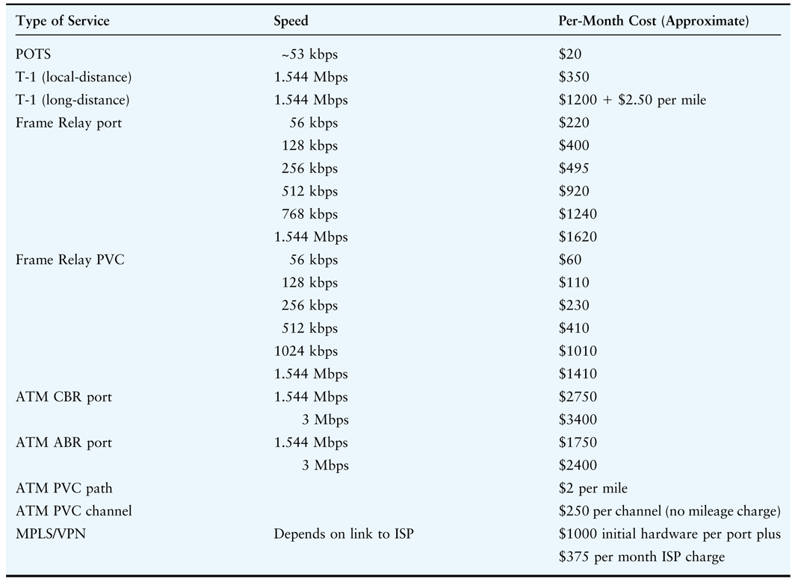
Telecommunication Systems In Action:
A Company Makes a Service Choice (continued)
Data Communications and Computer Networks: A Business User's Approach, Eighth Edition
© 2016. Cengage Learning. All Rights Reserved.

Slide 69
Telecommunication Systems In Action:
A Company Makes a Service Choice (continued)
To provide T-1 service to all four offices:
  Seattle to Chicago: $6325 ($1200 + $2.50 per mile)
  San Francisco to Chicago: $6625
  Dallas to Chicago: $3500
  Total interLATA T-1 costs = $16,450 / month
Data Communications and Computer Networks: A Business User's Approach, Eighth Edition
© 2016. Cengage Learning. All Rights Reserved.

Slide 70
Telecommunication Systems In Action:
A Company Makes a Service Choice (continued)
To provide frame relay service:
  Three ports at 256K = 3 x $495
  One port in Chicago at 512K = $920
  Three 256K PVCs = 3 x $230
  Four intraLATA T-1s = 4 x $350
  Total charge = $4495 / month
Data Communications and Computer Networks: A Business User's Approach, Eighth Edition
© 2016. Cengage Learning. All Rights Reserved.

Slide 71
Telecommunication Systems In Action:
A Company Makes a Service Choice (continued)
To provide asynchronous transfer mode service:
  Four ports at 1.544 Mbps ABR = 4 x $1750
  Three channels = 3 x $250
  Three paths = $2 per mile x 5140 miles = $10,280
  Four intraLATA T-1s = 4 x $350
  Total ATM charges = $19,430 / month
Data Communications and Computer Networks: A Business User's Approach, Eighth Edition
© 2016. Cengage Learning. All Rights Reserved.

Slide 72
Telecommunication Systems In Action:
A Company Makes a Service Choice (continued)
To provide MPLS/VPN solution:
  Initial VPN cost of $1000 per gateway per port = 4 x $1000
  Monthly charge of ISP connection at each port = 4 x $375
  Monthly charge of local-distance T-1 at each location = 4 x $350
  Monthly charge of $2900 per month after initial $4000 fee
Data Communications and Computer Networks: A Business User's Approach, Eighth Edition
© 2016. Cengage Learning. All Rights Reserved.

Slide 73
Summary
The basic telephone system that covers the U.S. is called plain old telephone service (POTS) and is a mix of analog and digital circuits
Divestiture of AT&T in 1984 opened the long-distance telephone market to other long-distance providers, forced AT&T to sell off its local telephone companies, and divided the country into local access transport areas (LATAs)
A PBX is an on-premise computerized telephone switch that handles all internal and outgoing telephone calls and offers a number of telephone services
Data Communications and Computer Networks: A Business User's Approach, Eighth Edition
© 2016. Cengage Learning. All Rights Reserved.

Slide 74
Summary (continued)
A Centrex offers same services as PBX, but equipment resides on telephone company’s property, and business leases the service
Telecommunications Act of 1996 opened local telephone service to new competitors and required existing local telephone companies to provide these competitors with access to local telephone lines
Leased lines are established by communications service provider and serve as permanent, private connections between two locations
Data rate of dial-up modems using voice-grade telephone lines has peaked a little less than 56,000 bits per second.
Data Communications and Computer Networks: A Business User's Approach, Eighth Edition
© 2016. Cengage Learning. All Rights Reserved.

Slide 75
Summary (continued)
Technologies such as digital subscriber line (DSL) and cable modems have improved data transfer rates available between homes and businesses and Internet service providers
T-1 service provides a digital connection of 1.544 Mbps between a company and a service provider
Frame relay is service that provides digital data transfer over long distances and at high data transfer rates (<45 Mbps)
Asynchronous Transfer Mode (ATM) is also a packet-switched service, but it supports all types of traffic and can operate at speeds faster than either T-1 or frame relay
Computer-telephony integration and unified communications are examples of convergence of data communications networks and voice systems
Data Communications and Computer Networks: A Business User's Approach, Eighth Edition
© 2016. Cengage Learning. All Rights Reserved.

